Slide 1
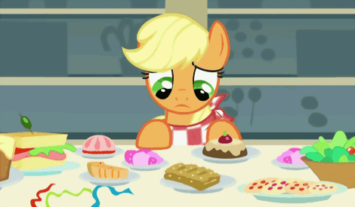
HUNGRY, HUNGRY
PONIES
X²
4
Anastasia Shpurik
Kira Combs
Maria Deslis
Nicola Hetrick

Slide 2
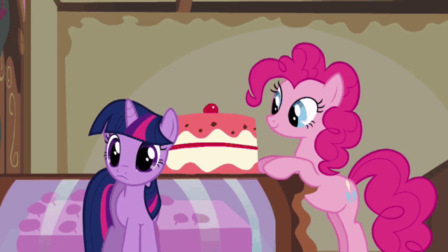
Hungry, Hungry Ponies follows young Mint Pudding as she risks her life to catapult and hopefully hit the glorious cake of strawberry. With each successful attempt, Mint Pudding will devour a layer of the cake, and with each failed attempt, she will lose a portion of her health.
What is Hungry, Hungry Ponies?

Slide 3
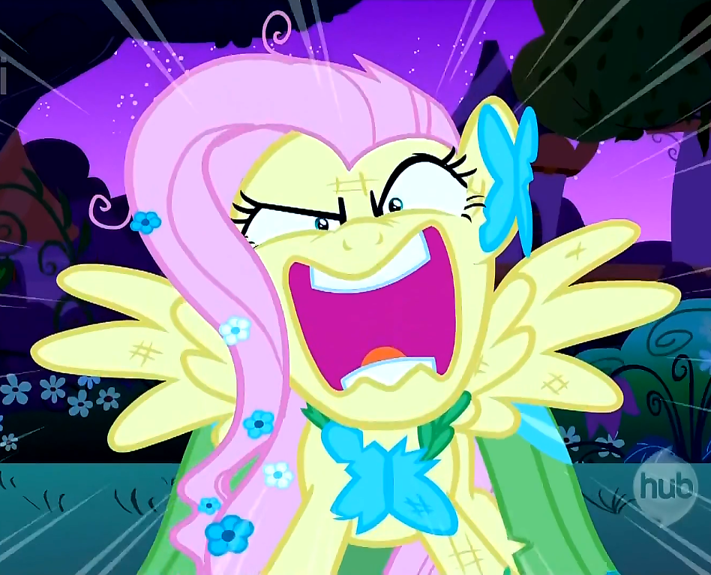
THE CAKE IS NOT A LIE!!!

Slide 4
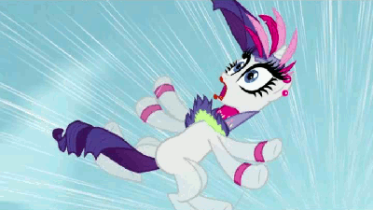
If she fails to consume all of the cake before her health is depleted, little Mint Pudding will not see the next sunrise.

Slide 5
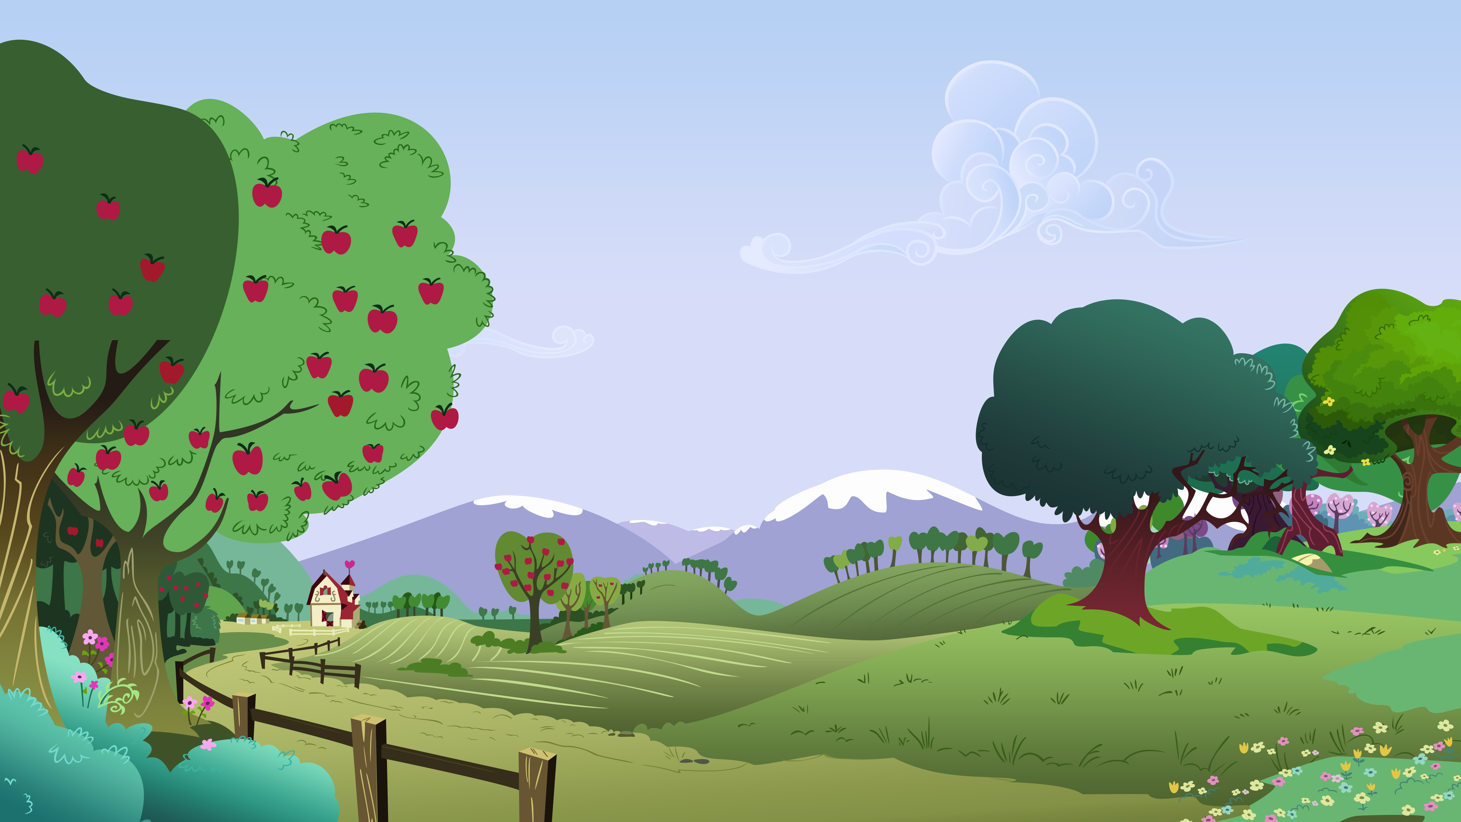
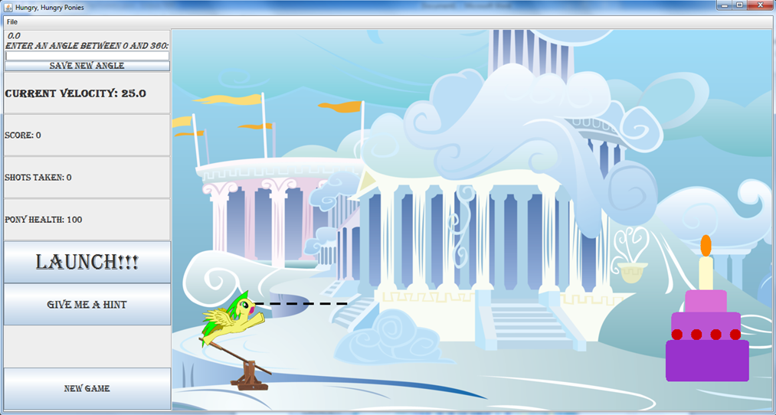
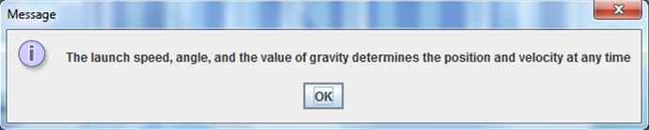
Angle Input (and save)
This is your target
This is your pony
This is your reference
information
Launch the Pony
Ask for a hint
Start a new game
Controls
This is your hint
Press okay to indicate you’ve read it

Slide 6
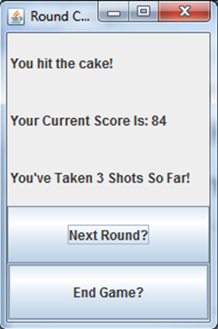
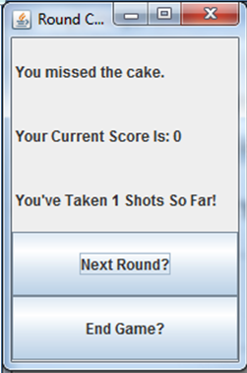
If you hit the cake…
If you miss the cake…
Current score and shots taken
Notice the changes…
Play the next round!
Give up and end the game
Controls

Slide 7

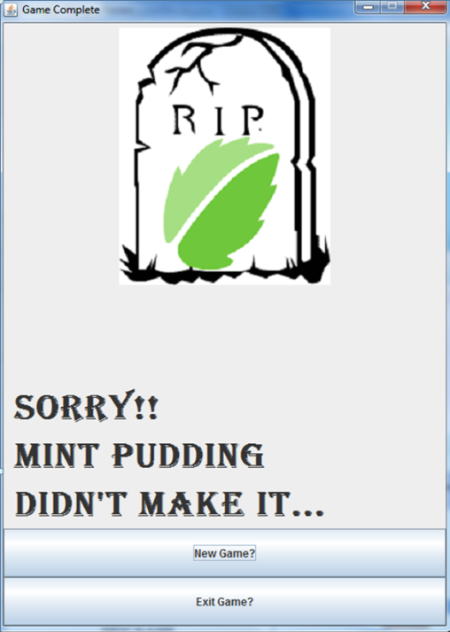
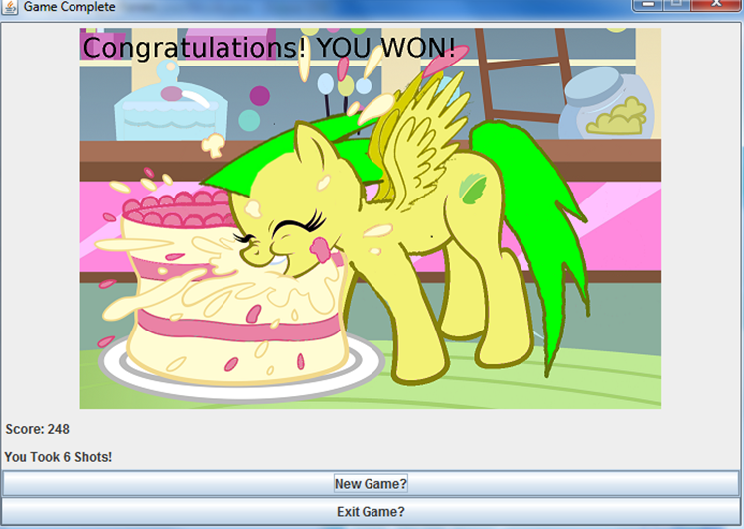
How to Win
Game lost
Game won
Start a new game
Quit

Slide 8
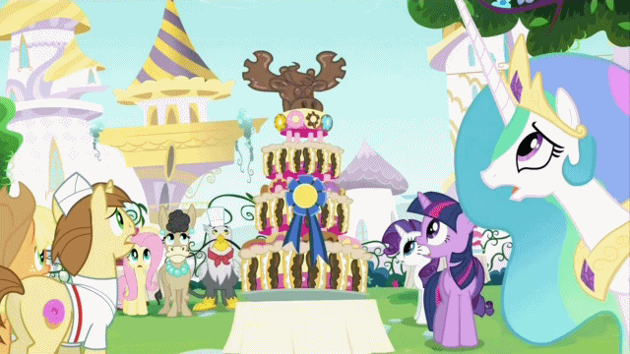
Successfully Eat all 4 layers of cake and win the Game!
How to Win

Slide 9

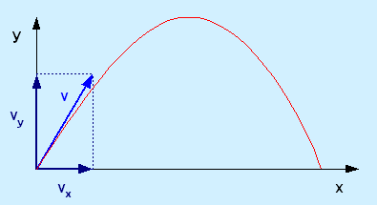
Materials:
Paper (to visualize the calculation)
Pencil (to draw :P)
Eraser (should you choose to make mistakes)
Calculator (unless you can do trig in your head)
NEED HELP???
Remember, there is no penalty in asking for a hint!

Slide 10
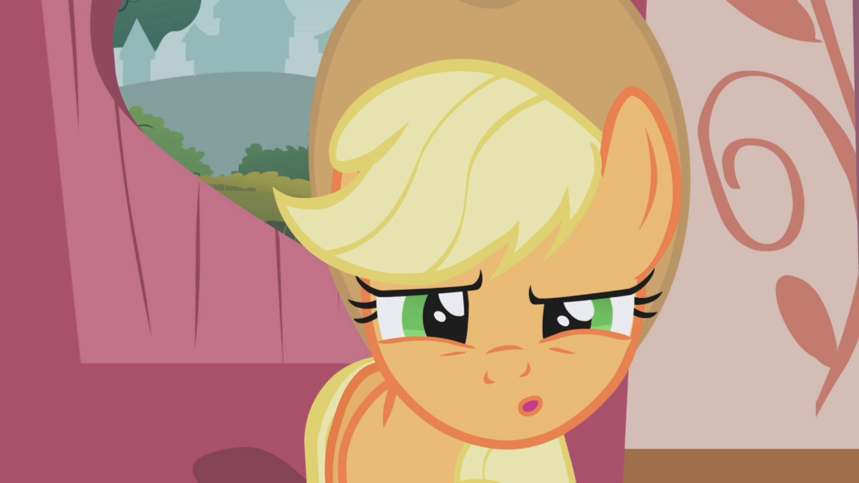
Questions?
Comments?
Concerns about our mental health?

